Slide 1


Phishing Awareness: Stay Safe Online
Learn to identify and avoid phishing attacks. Understand the risks of financial loss, identity theft, and data breaches. Explore real-world examples and key statistics.
by Atif Tiwale

Slide 2
Recognizing Phishing Emails: Red Flags
Suspicious Senders
Generic Greetings
Poor Grammar
Urgency
Typos and grammatical errors are indicators.
Demands for immediate action are a red flag.
Misspellings and unusual domains are common.
Beware of "Dear Customer" instead of your name.

Slide 3
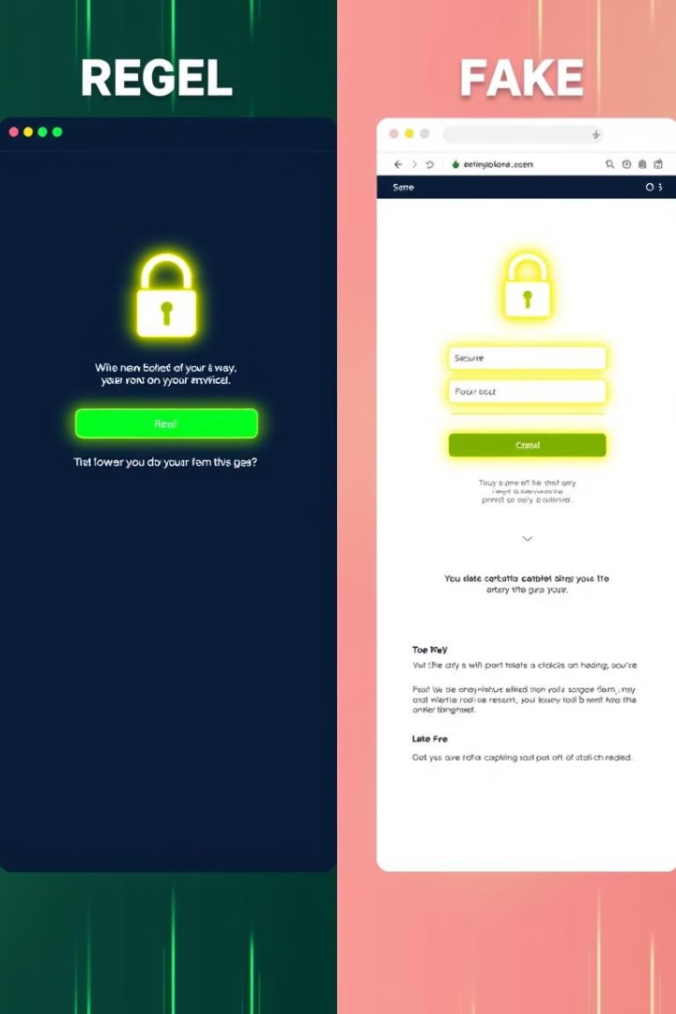
Spotting Phishing Websites: Fake vs. Real
Check the URL
Look for "HTTPS" and verify the domain name.
Examine the Design
Poor design and outdated logos are common.
Trust Seals
Verify the authenticity of security badges.
Contact Information
Check for valid phone numbers and addresses.

Slide 4





Understanding Social Engineering Tactics
Pretexting
False scenarios to trick you.
Baiting
Tempting offers to lure clicks.
Fear Tactics
Threats to force action.
Authority
Impersonating authority figures.
According to Verizon's 2023 Data Breach Investigations Report, 82% of breaches involved the human element.

Slide 5
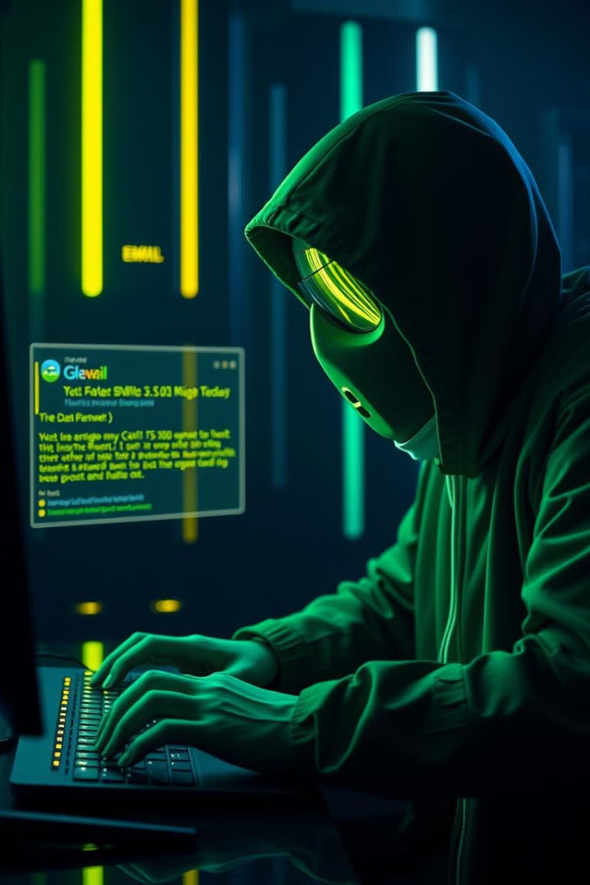
Phishing in the Age of AI
1
Convincing Emails
Deepfake Impersonation
AI makes emails more realistic.
2
AI-generated deepfakes are convincing.
3
Chatbot Information
AI chatbots extract user data.
Spear phishing attacks now use AI-researched personal details.

Slide 6
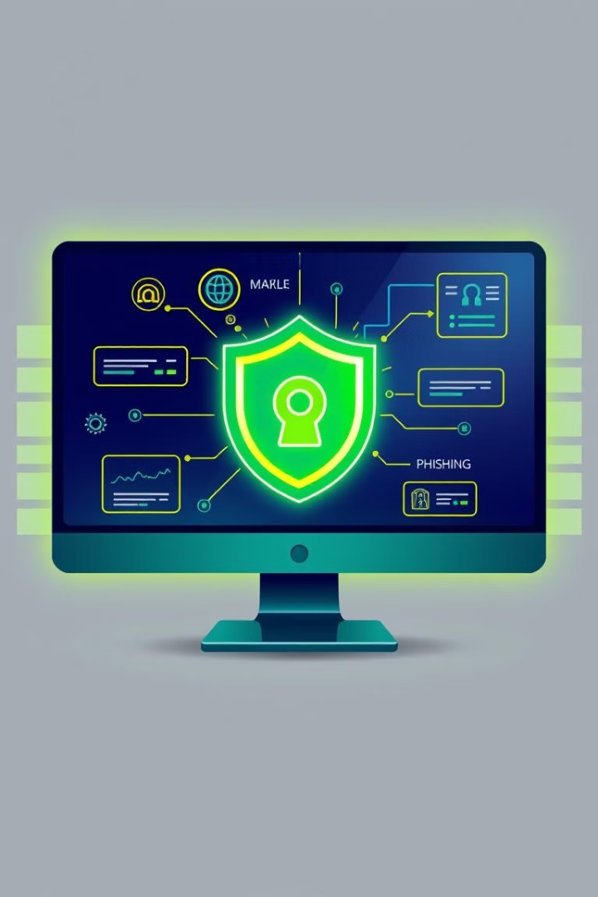




Protecting Yourself: Best Practices
Think Before You Click
Enable MFA
Update Software
Add extra security to accounts.
Verify links before clicking.
Regularly update your software.
Strong Passwords
Use unique, strong passwords.
Consider using a password manager to maintain unique, complex passwords.

Slide 7
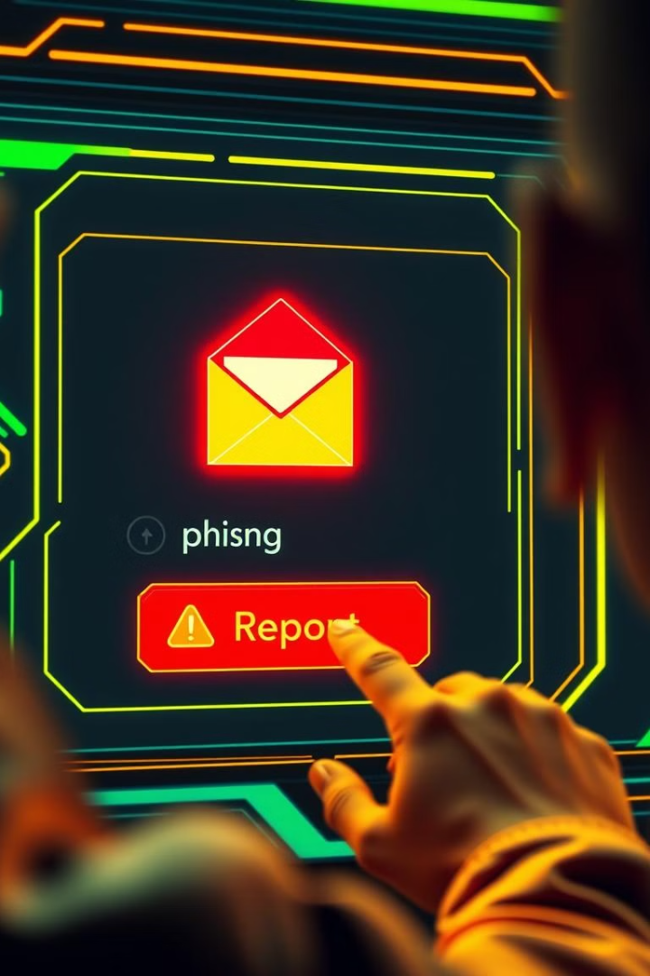
Reporting Phishing: What to Do
Report Emails
1
Forward suspicious emails to your IT department.
Report Websites
2
Report fake websites to Google Safe Browsing.
Change Passwords
3
Change compromised passwords immediately.
Monitor Accounts
4
Watch accounts for unauthorized activity.
The US FTC received 330,000 phishing complaints in 2023.

Slide 8



Stay Vigilant: Ongoing Phishing Education
2
Regular Training
1
Continuous Learning
Share Knowledge
3
Security is everyone's responsibility. Stay informed about new phishing techniques. Participate in training exercises. Educate others about phishing scams.

Slide 9

THANKS

